Slide 1
Static Analysis for Bug Finding
Benjamin Livshits

Slide 2
Compilers Can be Used for Bug Finding
A trend of compiler research
Started in 1991 with Intrinsa
  Bug finding tool called Prefix
  Looks for NULL dereferences
  Memory leaks (double-deletes, dangling pointers)
  Concurrency bugs (race conditions)
  etc.
Purchased by Microsoft
  Became Prefix/Prefast
  Used by MS internally on a regular basis

Slide 3
Why Compilers?
Observation:
  Many bugs can be found by analyzing the source code
  Compilers have access to the source
Security is an attractive application:
  The cost of a break-in is very high
  Sound static (compiler) analysis can find all bugs

Slide 4
Common Classes of Security Vulnerabilities
Server-type software
(C, C++)
Application software
(Java, C#, PHP)
Buffer overruns
Format string violations
SQL injections
Cross-site scripting attacks
HTTP splitting attacks
Directory traversal attacks
Session hijacking attacks
etc.

Slide 5
Buffer Overruns

Slide 6
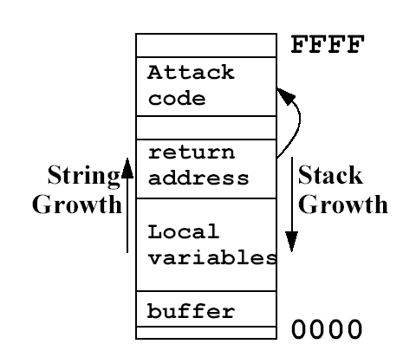
How Buffer Overruns Work
There is no array bounds checking in C
Hackers can exploit that
Different flavors of overruns
  Simplest: overrun a static buffer
  Idea: Don’t want user data to be copied to static buffers!
Arrange for suitable code to in program address space
Get the program to jump to that code
  overwrite a return address to point to the code
Put something interesting into the exploit code
  such as exec(“sh”), etc.

Slide 7
Example: Buffer Overrun in gzip
gzip.c:593
0589 if (to_stdout && !test && !list && (!decompress || ...
0590 SET_BINARY_MODE(fileno(stdout));
0591 }
0592 while (optind < argc) {
0593 treat_file(argv[optind++]);
gzip.c:716
0704 local void treat_file(iname)
0705 char *iname;
0706 {
...
0716 if (get_istat(iname, &istat) != OK) return;
gzip.c:1009
0997 local int get_istat(iname, sbuf)
0998 char *iname;
0999 struct stat *sbuf;
1000 {
...
1009 strcpy(ifname, iname);
Need to have a model of strcpy

Slide 8
A Glimpse of What Analysis is Needed
Need it to represent flow of date in C:
Yes if we can prove that p cannot point to a
Should we put a flow edge from 3 to a to represent potential flow?
If we don’t
  Analysis may miss bugs
If we do
  Analysis may end up being too imprecise
a = 2;
*p = 3;
… ← is the value of a still 2?

Slide 9
Application Level Vulnerabilities
(SQL Injection & Friends)

Slide 10
Real-Life Hacking Stories
blogger.com cracked Aug. 2005
Firefox marketing site hacked Jul. 2005
MS UK defaced in hacking attack Jul. 2005
Hacker hits Duke system Jun. 2005
MSN site hacked in South Korea Jun. 2005
MSN site hacking went undetected for days Jun. 2005
Phishers manipulate SunTrust site to steal data Sep. 2004
Tower Records settles charges over hack attacks Apr. 2004
Western Union Web site hacked Sep. 2000
75% of all security attacks today are at the application level*
97% of 300+ audited sites were vulnerable to Web application attacks*
$300K average financial loss from unauthorized access or info theft**
Average $100K/hour of downtime lost
* Source: Gartner Research
*Source: Computer Security Institute survey

Slide 11
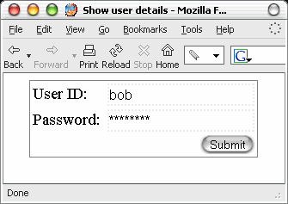
Simple Web App
Web form allows user to look up account details
Underneath – Java Web app. serving requests

Slide 12
SQL Injection Example
Happy-go-lucky SQL statement:
Leads to SQL injection
  One of the most common Web application vulnerabilities caused by lack of input validation
But how?
  Typical way to construct a SQL query using concatenation
  Looks benign on the surface
  But let’s play with it a bit more…
String query = “SELECT Username, UserID, Password
    FROM Users WHERE
      username =“ + user + “ AND
      password =“ + password;

Slide 13
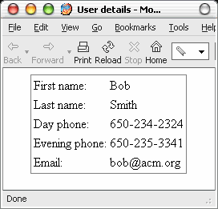
Injecting Malicious Data (1)
submit
query = “SELECT Username, UserID, Password
  FROM Users WHERE
  Username = 'bob'
  AND Password = ‘********‘”

Slide 14

Injecting Malicious Data (2)
submit
query = “SELECT Username, UserID, Password
  FROM Users WHERE
  Username = 'bob‘--
  ‘AND Password = ‘ ‘”

Slide 15
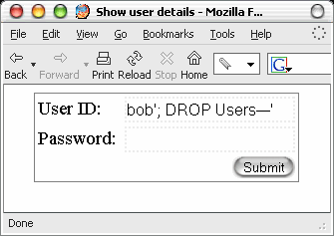

Injecting Malicious Data (3)
submit
query = “SELECT Username, UserID, Password
  FROM Users WHERE
  Username = 'bob‘; DROP Users--
  ‘AND Password = ‘‘”

Slide 16
Summary of Attacks Techniques
Input and output validation are at the core of the issue
Inject
(taint sources)
Parameter manipulation
Hidden field manipulation
Header manipulation
Cookie poisoning
Second-level injection
2. Exploit
(taint sinks)
SQL injections
Cross-site scripting
HTTP request splitting
HTTP request smuggling
Path traversal
Command injection
1. Header manipulation + 2. HTTP splitting = vulnerability

Slide 17
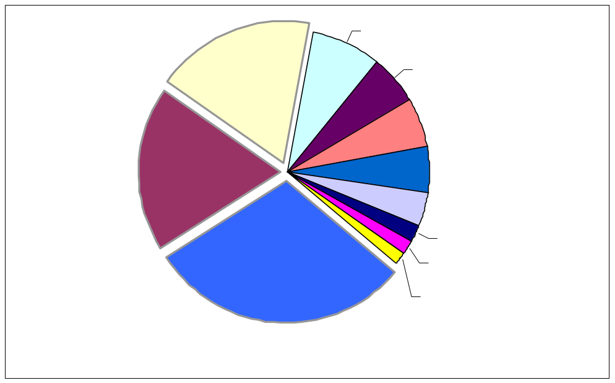
Focusing on Input/Output Validation
SQL injection and cross-site scripting are most prevalent
Buffer overruns are losing their market share
18%
19%
30%

Slide 18
Taint Propagation
String session.ParameterParser.getRawParameter(String name)
public String getRawParameter(String name) throws ParameterNotFoundException
{
String[] values = request.getParameterValues(name);
if (values == null)
{
throw new ParameterNotFoundException(name + " not found");
}
else if (values[0].length() == 0)
{
throw new ParameterNotFoundException(name + " was empty");
}
return (values[0]);
}
ParameterParser.java:586
String session.ParameterParser.getRawParameter(String name, String def)
public String getRawParameter(String name, String def) {
try
{
return getRawParameter(name);
}
catch (Exception e)
{
return def;
}
}
ParameterParser.java:570
Element lessons.ChallengeScreen.doStage2(WebSession s)
  String user = s.getParser().getRawParameter( USER, "" );
  StringBuffer tmp = new StringBuffer();
  tmp.append("SELECT cc_type, cc_number from user_data WHERE userid = '“);
  tmp.append(user);
  tmp.append("'“);
  query = tmp.toString();
  Vector v = new Vector();
  try
  {
  ResultSet results = statement3.executeQuery( query );
  ...
ChallengeScreen.java:194

Slide 19

Why Pointer Analysis?
Imagine manually auditing an application
  Two statements somewhere in the program
  Can these variables refer to the same object?
Question answered by pointer analysis...
// get Web form parameter
String param = request.getParameter(...);
...
...
...
// execute query
con.executeQuery(query);
Notes:
Two statements somewhere in the program
Variables in the program refer--or point--to runtime objects

Slide 20
Pointers in Java?
Java references are pointers in disguise
Stack
Heap

Slide 21
What Does Pointer Analysis Do for Us?
Statically, the same object can be passed around in the program:
  Passed in as parameters
  Returned from functions
  Deposited to and retrieved from data structures
  All along it is referred to by different variables
Pointer analysis “summarizes” these operations:
  Doesn’t matter what variables refer to it
  We can follow the object throughout the program
a
b
c
Notes:
Show code examples instead

Slide 22
Recurring Issues
Static analysis is a powerful approach to finding bugs in program at the source
Soundness: find all bugs of a kind
  Marking every line of the program as a problem achieves that
Precision: low rate of false positives
  can have an extremely precise sound analysis but takes years to run
Scalability:
  Want to analyze programs 10,000-50,000 LOC
  Some analyses go up to 1M LOC

